Slide 1

sort of want to be want to be really want to be
Notes:
scale

Slide 2
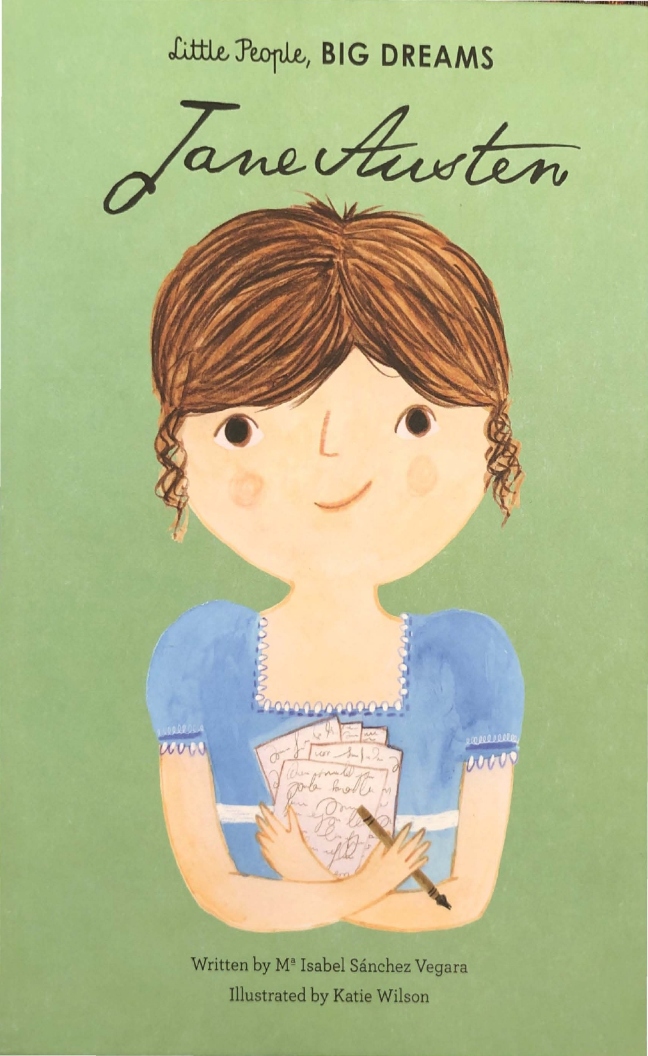
Context: girl to boy (positive): Jane Austen
This is a story about Jane Austen, who ended up becoming a famous writer.

Slide 3
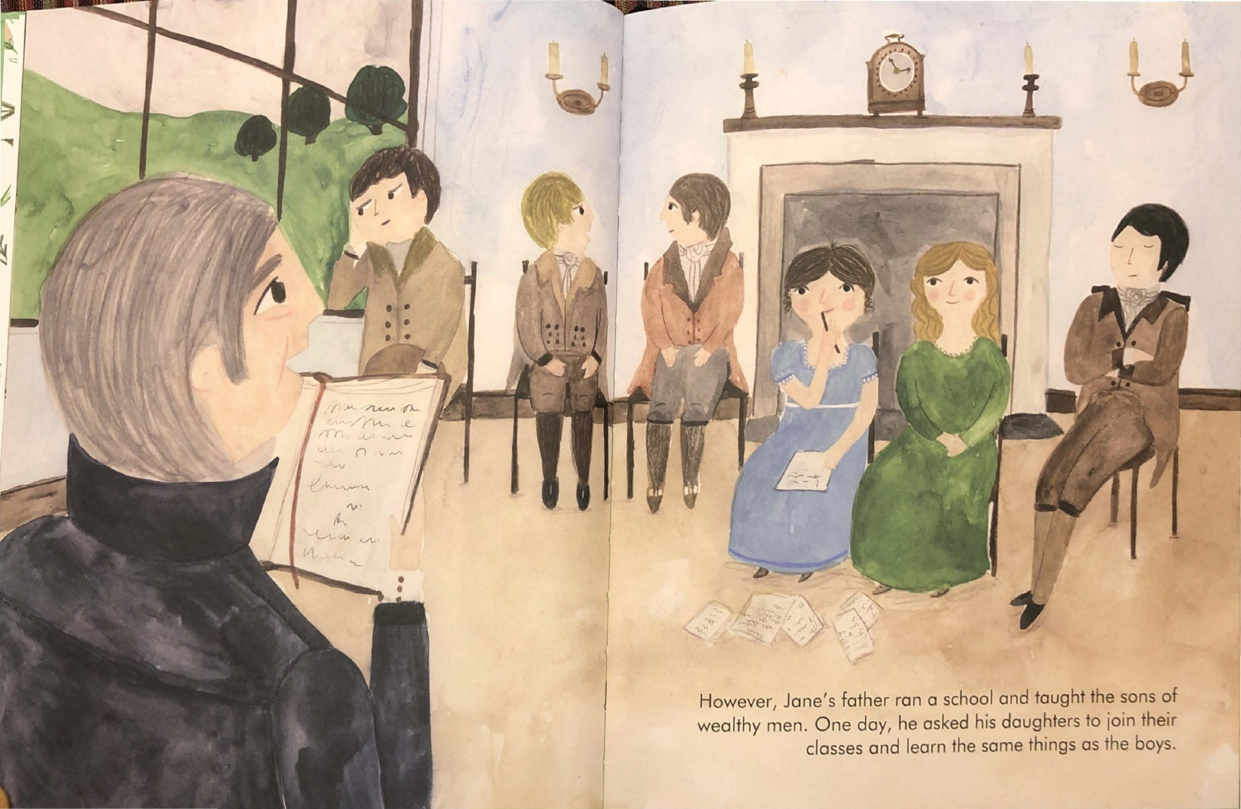
Passage: girl to boy (positive): Jane Austen
Original
Edited
When Jane was growing up, girls weren’t allowed to go to school.
Jane’s father was the principal of a school for boys. One day, he asked his daughters to join the boys’ classes. He thought his daughters could learn to read and write just as well as the boys.
When Jane was growing up, not everyone was allowed to go to school.
Jane’s father was the principal of a school. One day, he asked his children to join the classes at his school, so that they could learn to read and write.

Slide 4
Check: girl to boy (positive): Jane Austen
“Did Jane Austen want to become a writer?” (y/n)

Slide 5
belief about own motivation: girl to boy: Jane Austen
Do you want to be a writer when you grow up? (Y/N)
If yes: “How much do you want to be a writer when you grow up?” (faces scale from Lin)
(no is 0) sort of want to be want to be really want to be

Slide 6
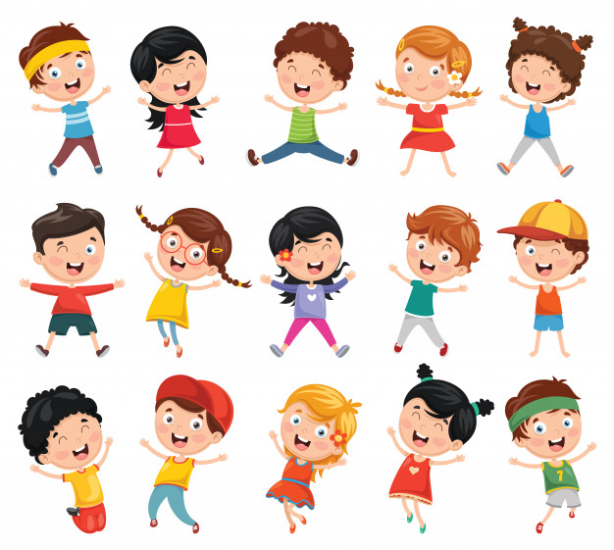
belief about girl motivation: girl to boy: Jane Austen
Here’s Sally.
Do you think Sally wants to be a writer when she grows up? (Y/N)
If yes: “How much do think Sally wants to be a writer when she grows up?” (faces scale from Lin)
(no is 0) sort of want to be want to be really want to be

Slide 7
belief about boy motivation: girl to boy: Jane Austen
Here’s Tommy.
Do you think Tommy wants to be a writer when he grows up? (Y/N)
If yes: “How much do think Tommy wants to be a writer when he grows up?” (faces scale from Lin)
(no is 0) sort of want to be want to be really want to be

Slide 8
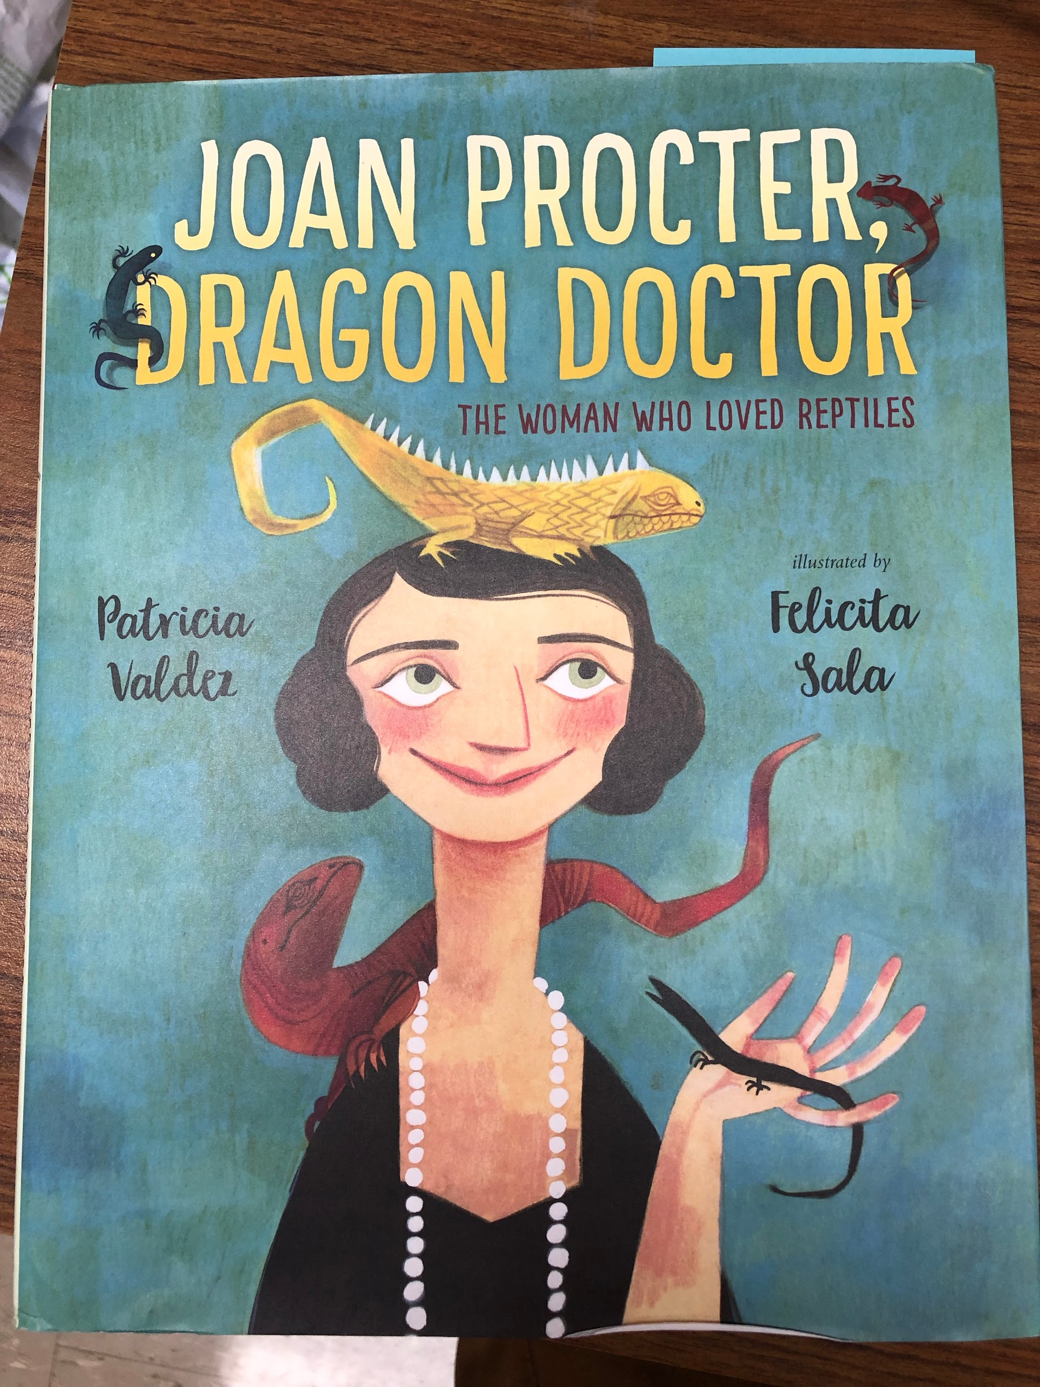
Context: girl to girl: Joan Procter
This is a story about Joan Procter, who ended up becoming a famous scientist who studied lizards.

Slide 9
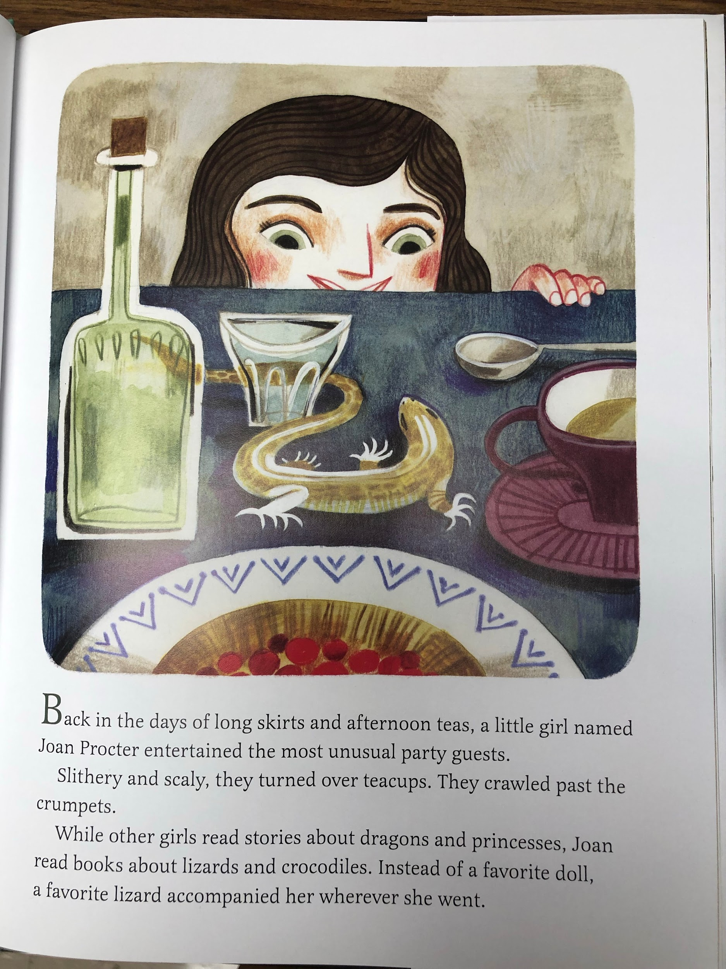
Passage: girl to girl: Joan Procter
Original
While other girls read stories about dragons and princesses, Joan read books about lizards and crocodiles. Instead of a favorite doll, a favorite lizard accompanied her wherever she went.
Edited
When she was a girl, Joan read books about lizards and crocodiles. A favorite lizard accompanied her wherever she went.

Slide 10
Check: girl to girl: Joan Procter
“Did Joan Procter want to become a scientist who studied lizards?” (y/n)

Slide 11
belief about own motivation: girl to girl: Joan Procter
Do you want to be a scientist when you grow up? (Y/N)
If yes: “How much do you want to be a scientist when you grow up?” (faces scale from Lin)
(no is 0) sort of want to be want to be really want to be

Slide 12
belief about boy motivation: girl to girl: Joan Procter
Here’s Jason.
Do you think Jason wants to be a scientist when he grows up? (Y/N)
If yes: “How much do think Jason wants to be a scientist when he grows up?” (faces scale from Lin)
(no is 0) sort of want to be want to be really want to be

Slide 13
belief about girl motivation: girl to girl: Joan Procter
Here’s Alice.
Do you think Alice wants to be a scientist when she grows up? (Y/N)
If yes: “How much do think Alice wants to be a scientist when she grows up?” (faces scale from Lin)
(no is 0) sort of want to be want to be really want to be

Slide 14
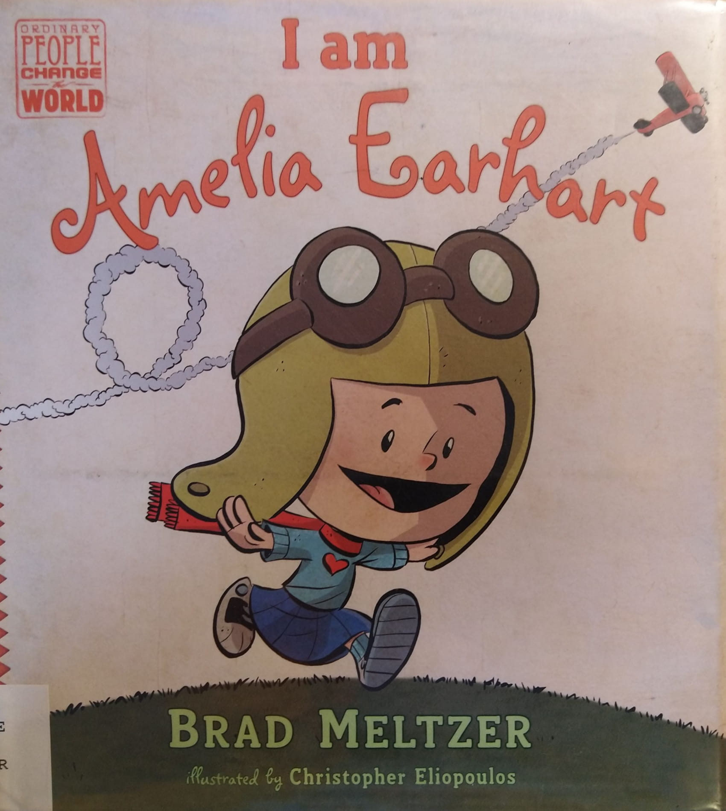
Context: exceptionalism (achievement): Amelia Earhart
*change title from I Am Amelia Earhart to Amelia Earhart
This is a story about Amelia Earhart, who ended up becoming a famous pilot.

Slide 15
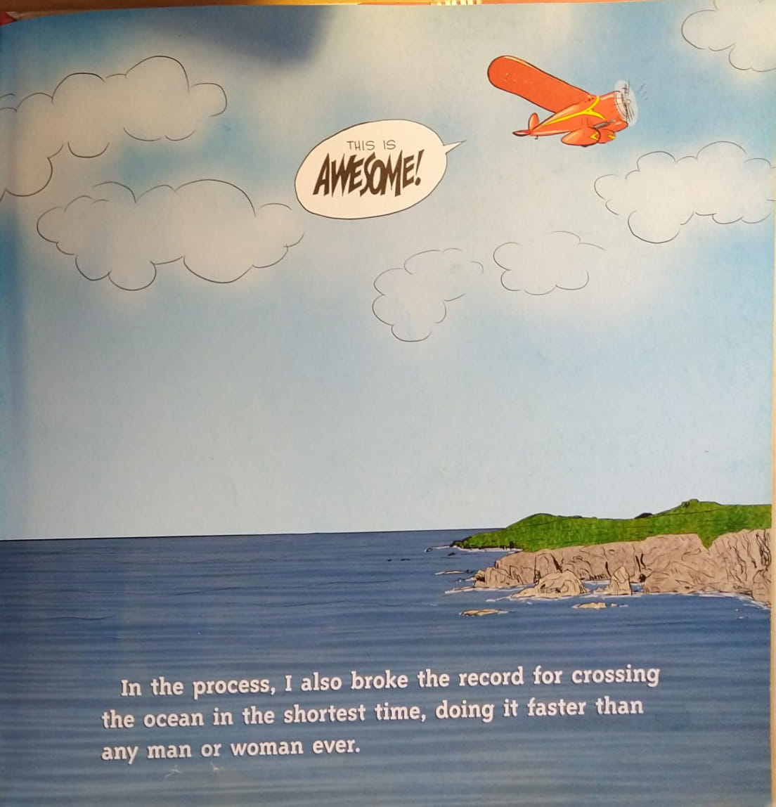
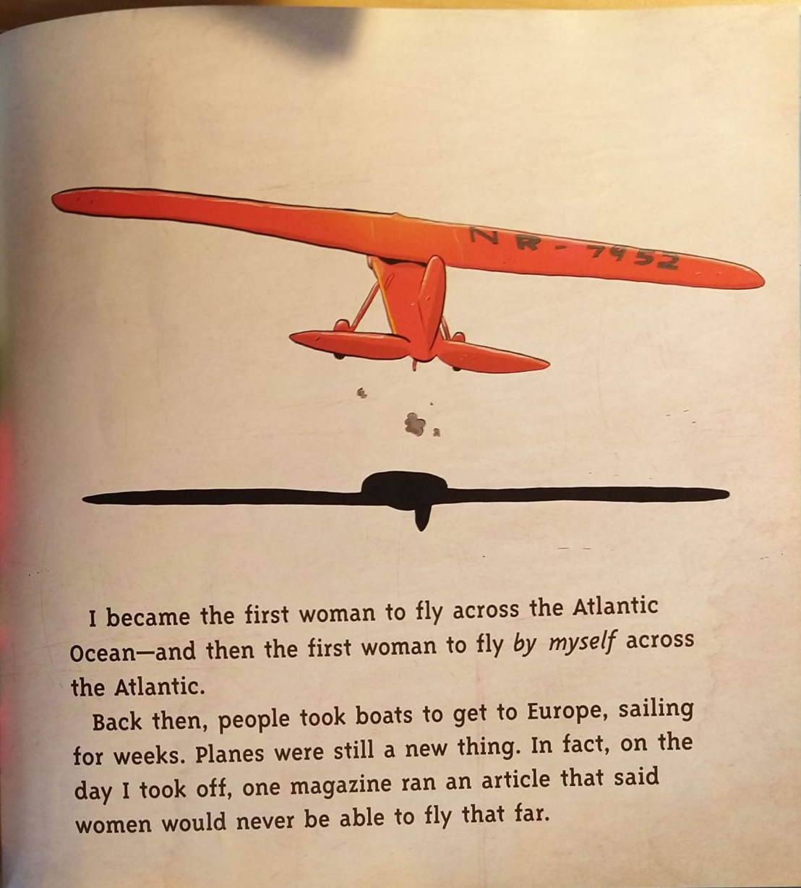
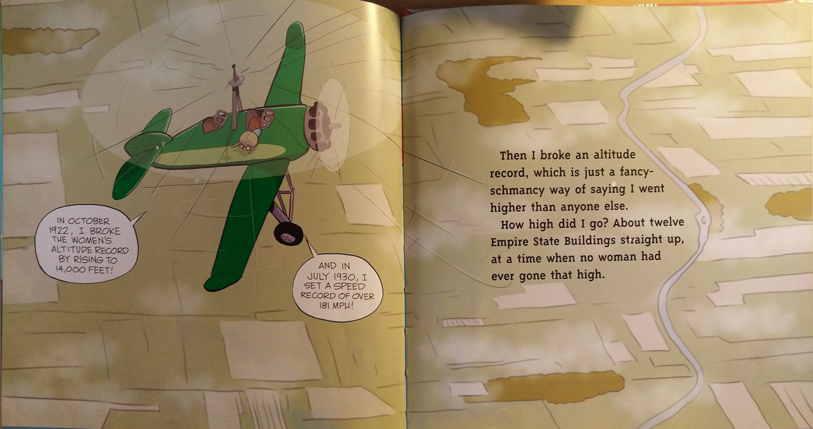
Passage: exceptionalism (achievement): Amelia Earhart
Original
"I became the first woman to fly across the Atlantic Ocean - and then the first woman to fly *by myself* across the Atlantic"
"In the process, I also broke the record for crossing the ocean in the shortest time, doing it faster than any man or woman ever... then I broke an altitude record... I went higher than anyone else... at a time when no woman had ever gone that high"
Edited
I flew across the Atlantic Ocean, and then flew by myself across the Atlantic. I crossed the ocean in a short time. I flew very fast and very high.

Slide 16
Check: exceptionalism (achievement): Amelia Earhart
“Did Amelia Earhart want to become a pilot?” (y/n)

Slide 17
belief about own motivation: exceptionalism: Amelia Earhart
Do you want to be a pilot when you grow up? (Y/N)
If yes: “How much do you want to be a pilot when you grow up?” (faces scale from Lin)
(no is 0) sort of want to be want to be really want to be

Slide 18
belief about girl motivation: exceptionalism: Amelia Earhart
Here’s Mara.
Do you think Mara wants to be a pilot when she grows up? (Y/N)
If yes: “How much do think Mara wants to be a pilot when she grows up?” (faces scale from Lin)
(no is 0) sort of want to be want to be really want to be

Slide 19
Here’s Chris.
Do you think Chris wants to be a pilot when he grows up? (Y/N)
If yes: “How much do think Chris wants to be a pilot when he grows up?” (faces scale from Lin)
(no is 0) sort of want to be want to be really want to be
Notes:
belief about boy motivation: exceptionalism: Amelia Earhart

